Slide 1
Cell Behaviour Modeling Platform
Ryan Carey, Lewis Kindeleit, Antoine Messager

Slide 2
Design aims
Flexibly & efficiently
reproduce biologically realistic behaviour
Graphical or prompt
Graphical or binary
<number>

Slide 3
Design choices
Agent-based models
<number>

Slide 4
Agent-based models (ABMs)
Suited to modelling interdependent modules (e.g. cells)
Flexible
Can model heterogenous entities with heterogenous interaction network. (Kaul 2015)
Growing in popularity with increasing computing power
<number>

Slide 5

Design choices
Agent-based models
Continuous space
Different types of cells
Environment modelled with PDEs
Julia Language
<number>

Slide 6
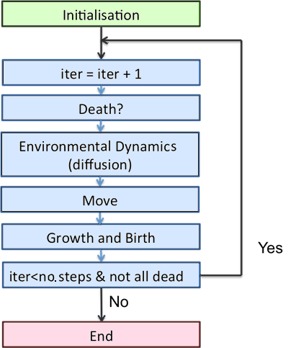
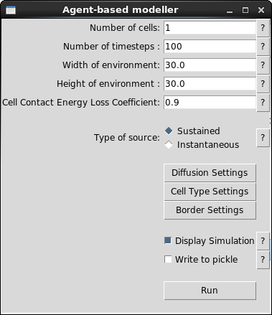
Model overview
<number>

Slide 7
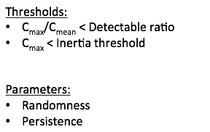

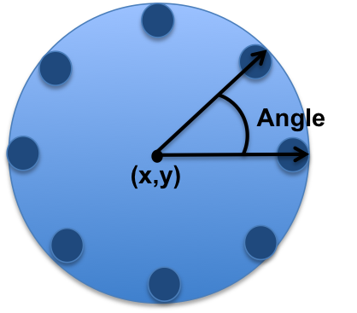
Cell Model
Explanation of cell division
<number>

Slide 8
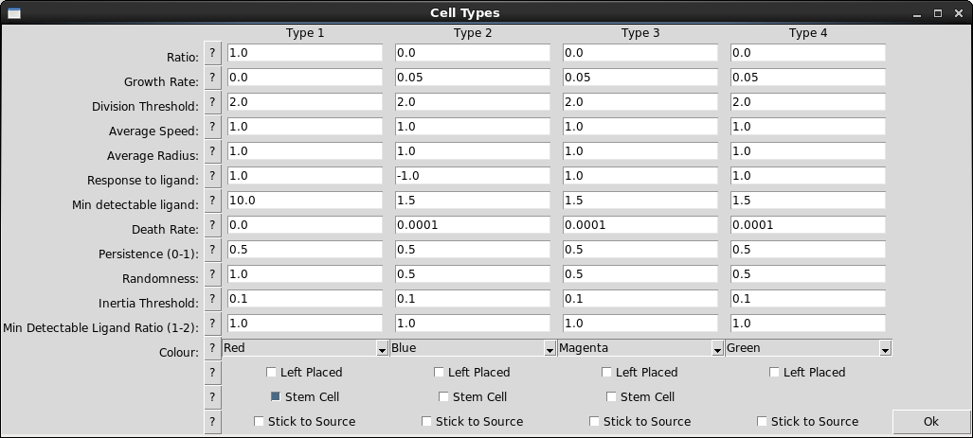
Cell Model Interface
<number>

Slide 9
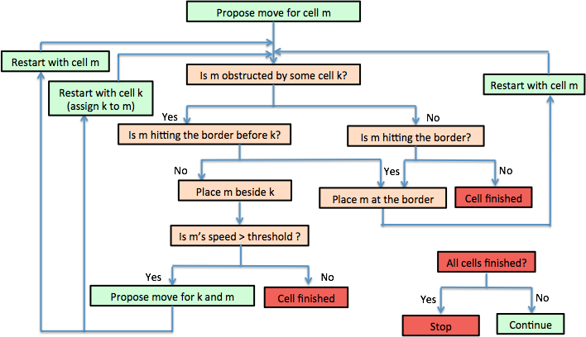
Cell Ballistic
<number>

Slide 10
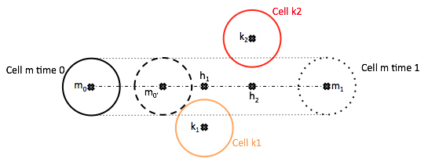
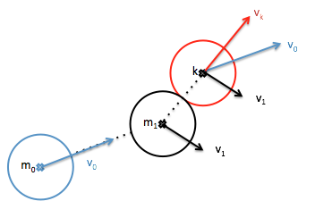

Cell-Cell Interaction
<number>

Slide 11
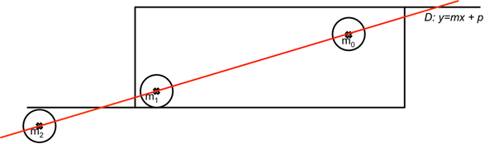
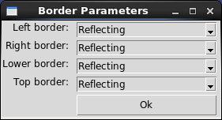
Cell-Wall interaction
<number>

Slide 12


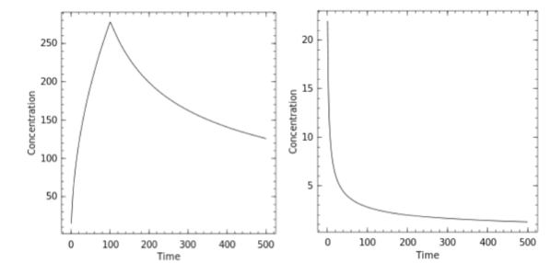
Diffusion
Sustained
Instantaneous
<number>

Slide 13
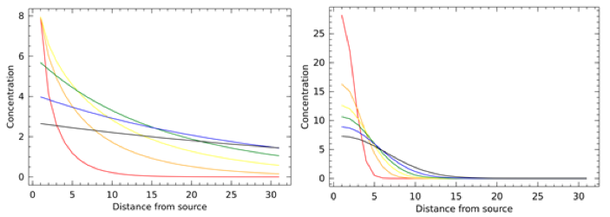
Diffusion Illustration
<number>

Slide 14
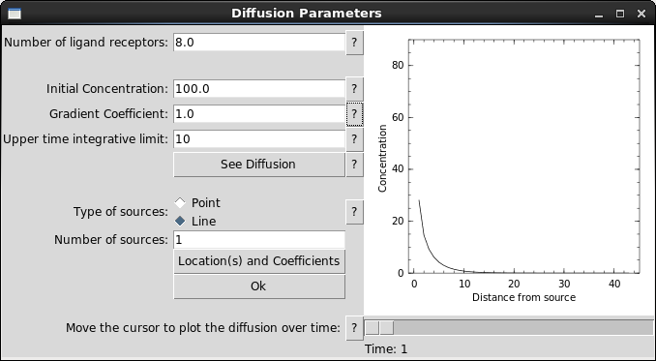
Diffusion Interface
VIDEO of the integrative diffusion instead and click on the location and coefficient button to show the other interface
<number>

Slide 15
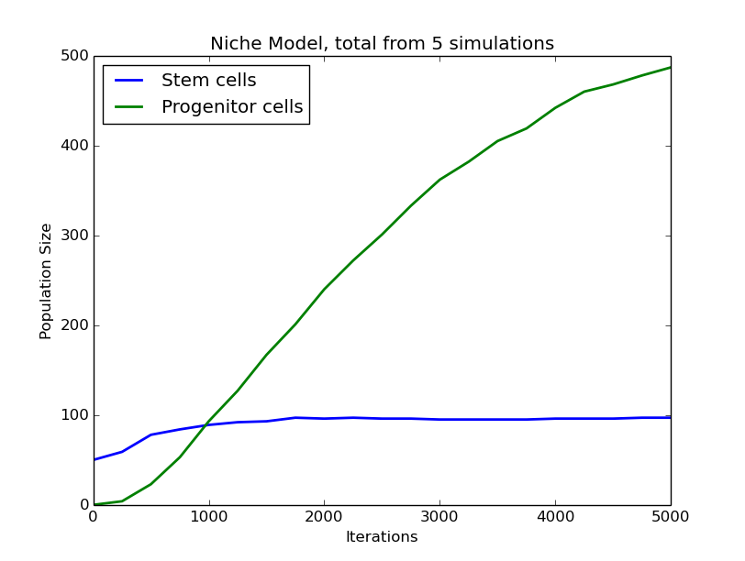
Example: Stem Cell Replication
<number>

Slide 16
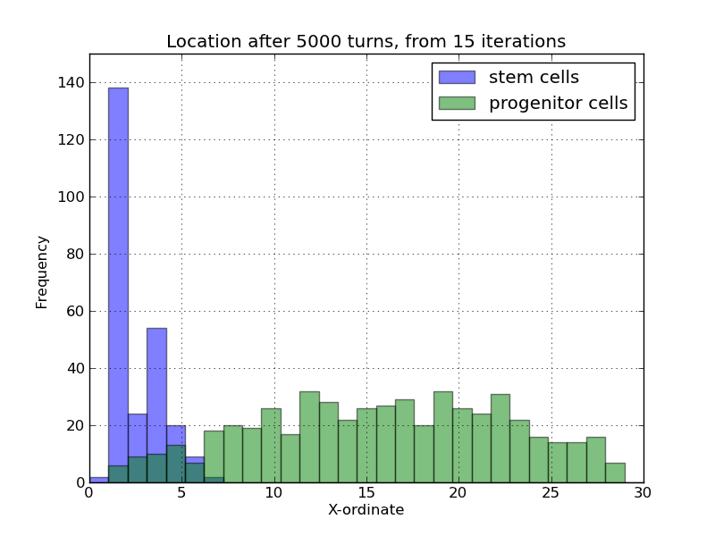
Example: Stem Cell Replication

Slide 17
Example: Macrophage Migration

Slide 18
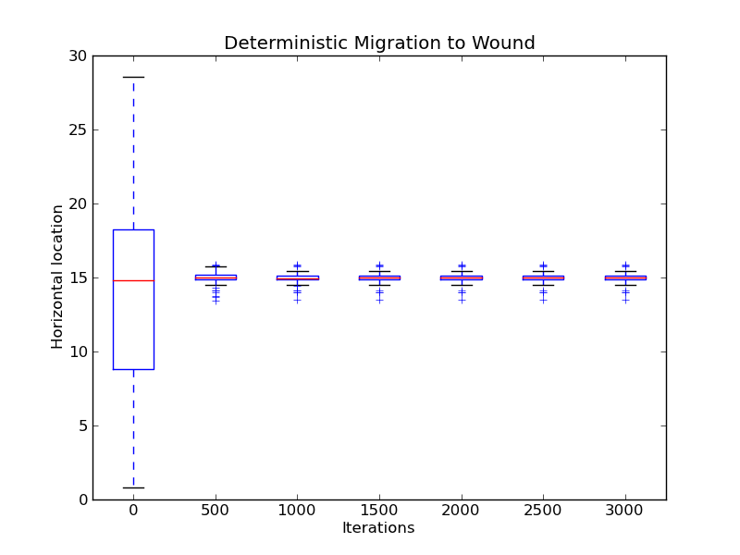
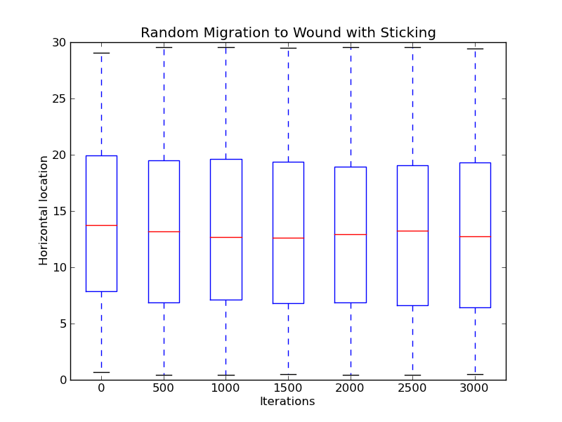
Example: Macrophage Migration

Slide 19
References
Kaul, Himanshu, and Yiannis Ventikos. "Investigating biocomplexity through the agent-based paradigm." Briefings in bioinformatics 16.1 (2015): 137-152.
<number>

